Slide 1
Modeling Maturity and Fecundity in Stock Synthesis

Slide 2
Maturity
Options to model maturity:
Logistic function of length
Logistic function of age
Input vector of maturity at each age
Input vector of fecundity at each age (ignore maturity)
Shell out to read fecundity and body weight-at-age from file, wtatage.ss

Slide 3
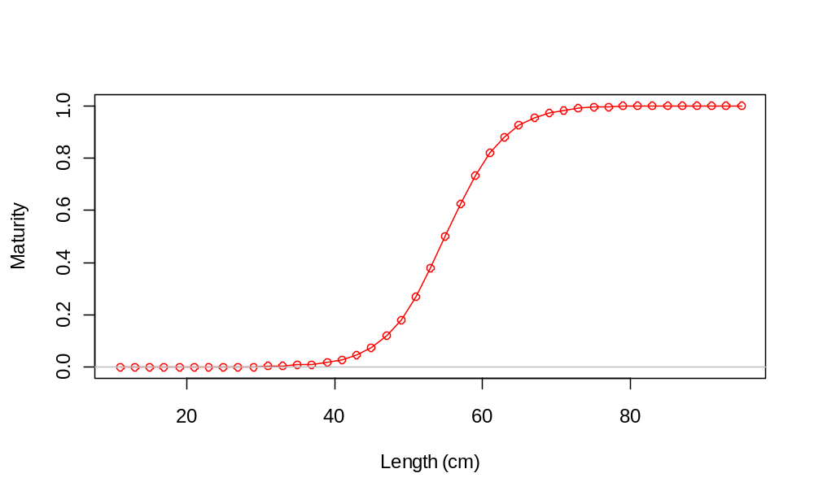
More on maturity
Parameters of logistic are length (or age) at 50% maturity and slope.
Extra input “first mature age” avoids youngest fish being mature, regardless of size

Slide 4
Fecundity
Options to model fecundity if maturity uses option 1, 2 or 3:
Fixed vector of fecundity at age
Function of weight or length
  fecundity = W(a+bW)
  fecundity = aL^{b}
  fecundity = aW^{b}
Males are included in the calculation of spawning biomass only when hermaphroditism option is used

Slide 5
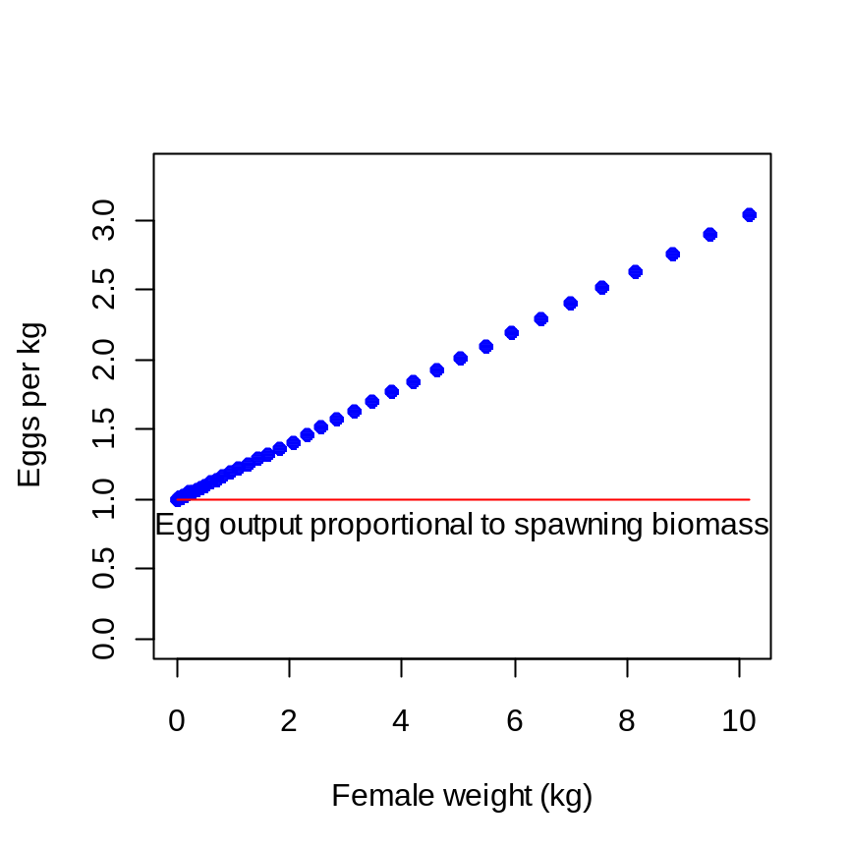
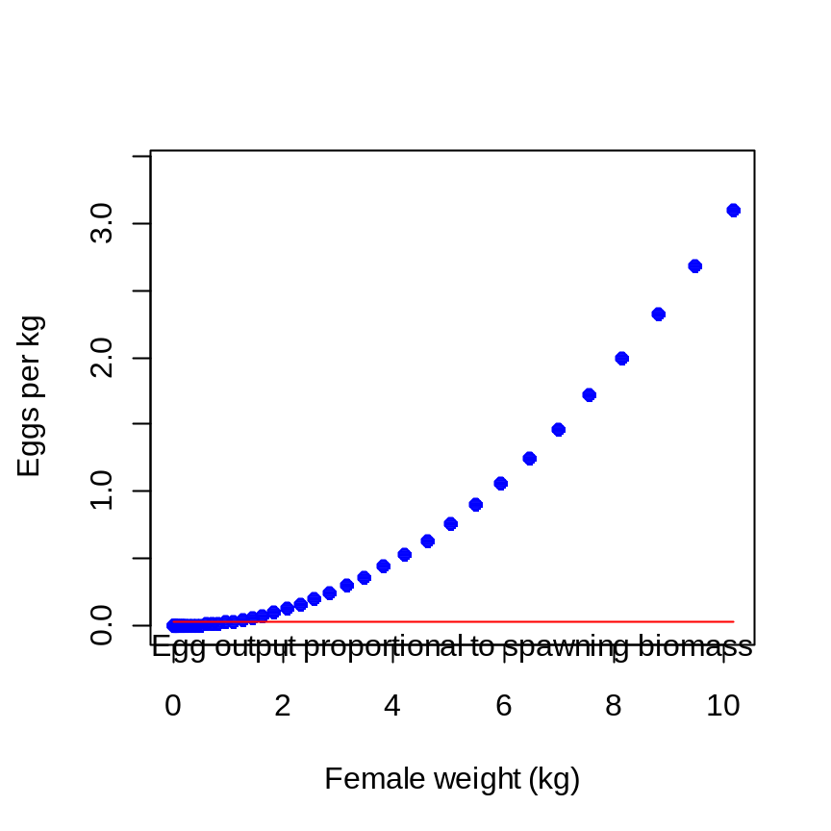
Fecundity
  fecundity = W(a+bW)
  fecundity = aW^{b}

Slide 6
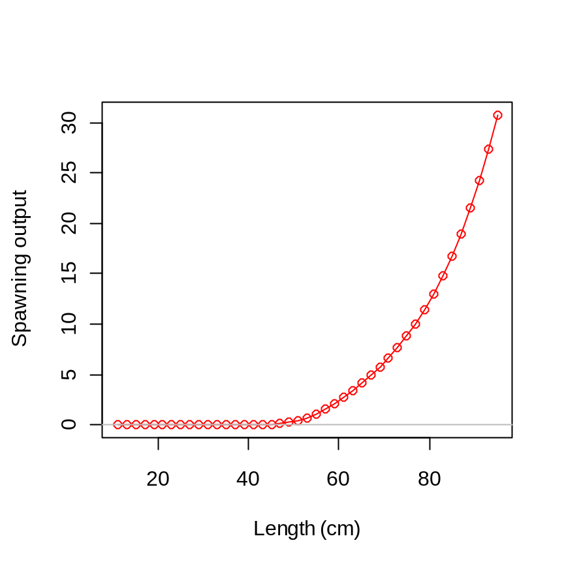
Spawning output
Maturity x Fecundity
Model tracks numbers at age,
but maturity, fecundity, and their product account for distribution
of length at each age

Slide 7
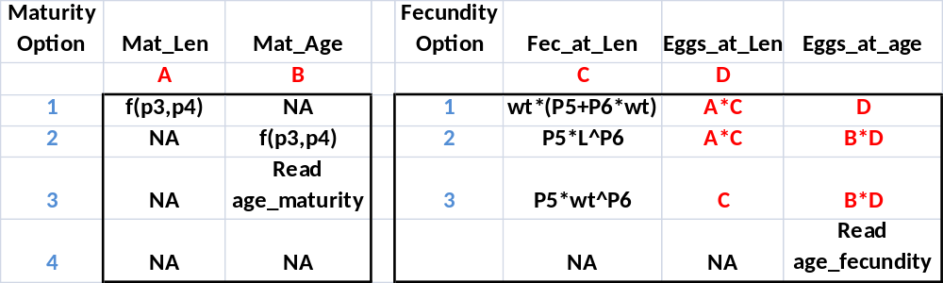
Maturity & Fecundity Options

